Slide 1
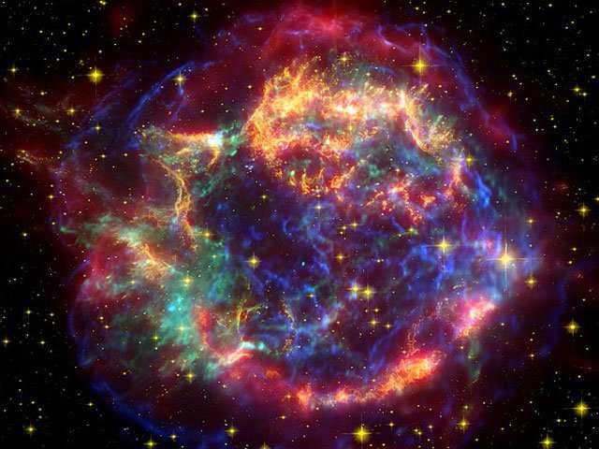
Neutron Star cooling &
Bayesian analysis for hybrid star
Hovik Grigorian:
JINR – Dubna
Yerevan State University
HMEC - 2016
Dubna 3 Nov.
my co-authors: D.Blaschke, D.Voskresensky,
D. Alvarez-Castillo , A. Ayriyan, S. Typel
Notes:
1
1

Slide 2
Cooling Of Neutron Stars
Introduction to Cooling Simulation
Cooling regulators
Time Evolution of Temperature
Super conductivity & in-medium effects
Results for NS cooling
H. Grigorian, D. N. Voskresensky and D. Blaschke
Eur. Phys. J. A 52: 67 (2016).
Notes:
2

Slide 3
Phase Diagramm & Cooling Simulation
Description of the stellar matter - local properties (EoS of super-dense matter)
Modeling of the gravitationally self bound compact star - including the density profiles
Extrapolations of the energy loss mechanisms to higher densities and temperatures
Consistency of the approaches
Comparison with observational data

Slide 4
Phase Diagramm & Cooling Simulation
Description of the stellar matter - local properties (EoS of super-dense matter)
Modeling of the gravitationally self bound compact star - including the density profiles
Extrapolations of the energy loss mechanisms to higher densities and temperatures
Consistency of the approaches
Comparison with observational data

Slide 5
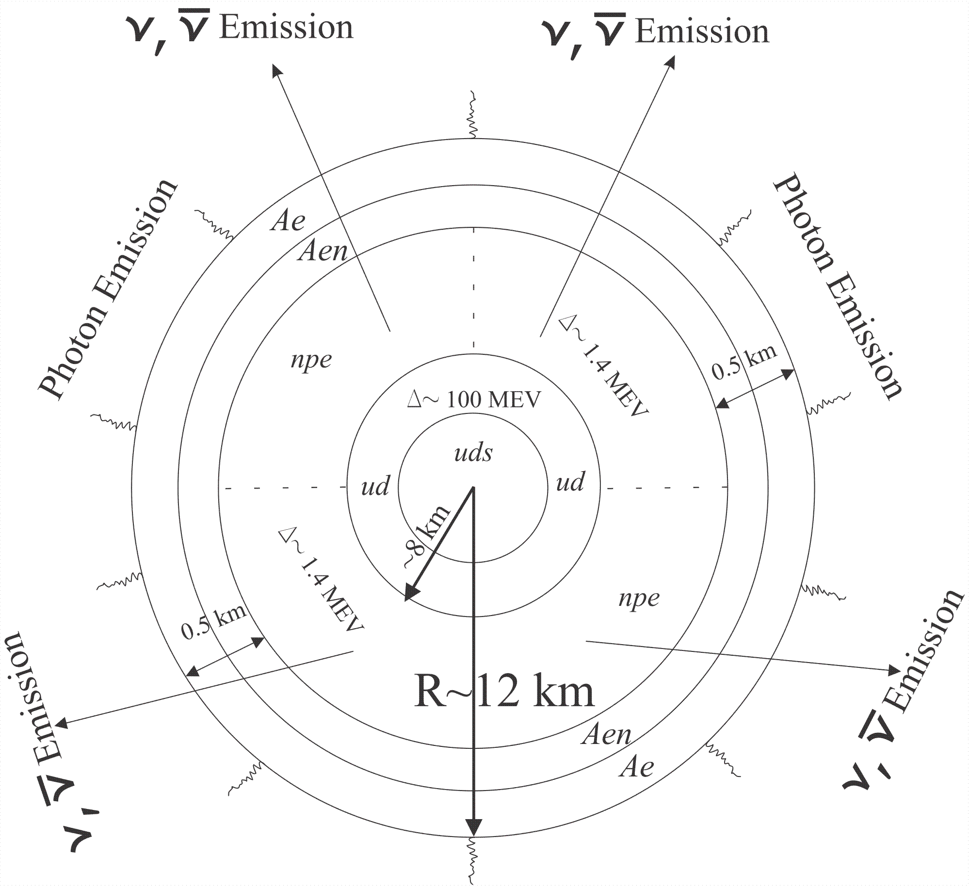
Structure Of Hybrid Star
1
1

Slide 6
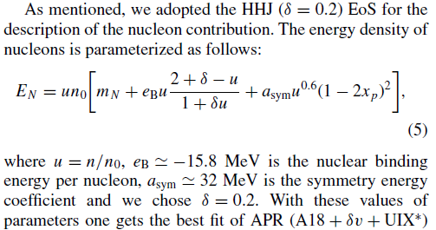

Modification of HHJ (HDD) parameterization of EoS
Introduction of the excluded volume

Slide 7
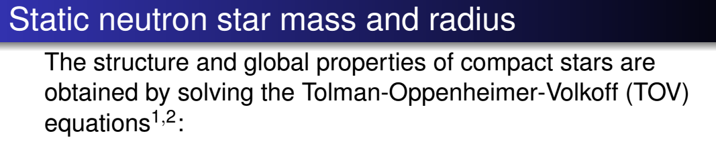
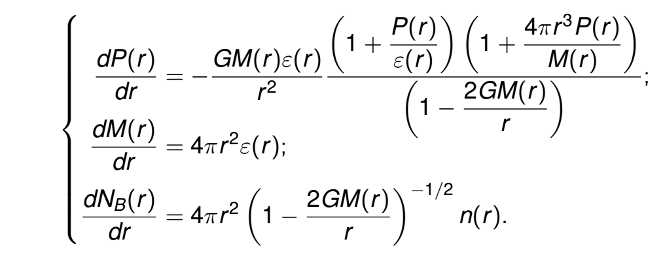


Slide 8
Stability of stars
HDD, DD2 & DDvex-NJL EoS model

Slide 9
Different EoS model Configurations for the same mass NS

Slide 10
Data of NS on Magnetic Field
Magnetars
AXPs, SGRs
B = 10^14 -10^15 G
Radio-quiet
NSs
B = 10^13 G
Radio-pulsar
NSs
B = 10^12 G
Radio-pulsar
NSs
B = 10^12 G
H - spectrum

Slide 11
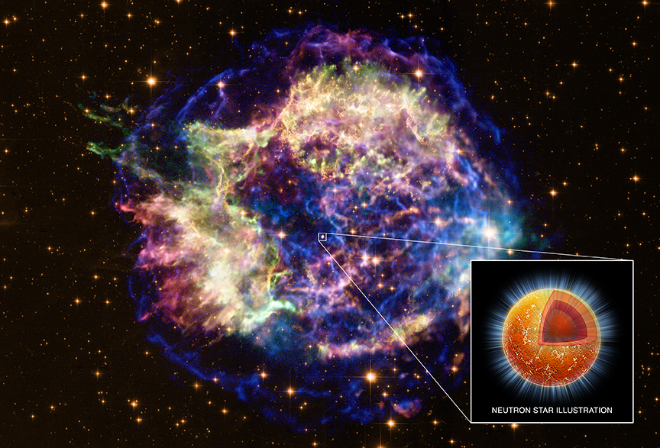
Neutron Star
in Cassiopeia A
16.08.1680 John Flamsteed, 6m star 3 Cas
1947 re-discovery in radio
1950 optical counterpart
T ∼ 30 MK
V exp ∼ 4000 − 6000 km/s
distance 11.000 ly = 3.4 kpc
picture: spitzer space telescope
D.Blaschke, H. Grigorian, D. Voskresensky, F. Weber,
Phys. Rev. C 85 (2012) 022802
e-Print: arXiv:1108.4125 [nucl-th]

Slide 12
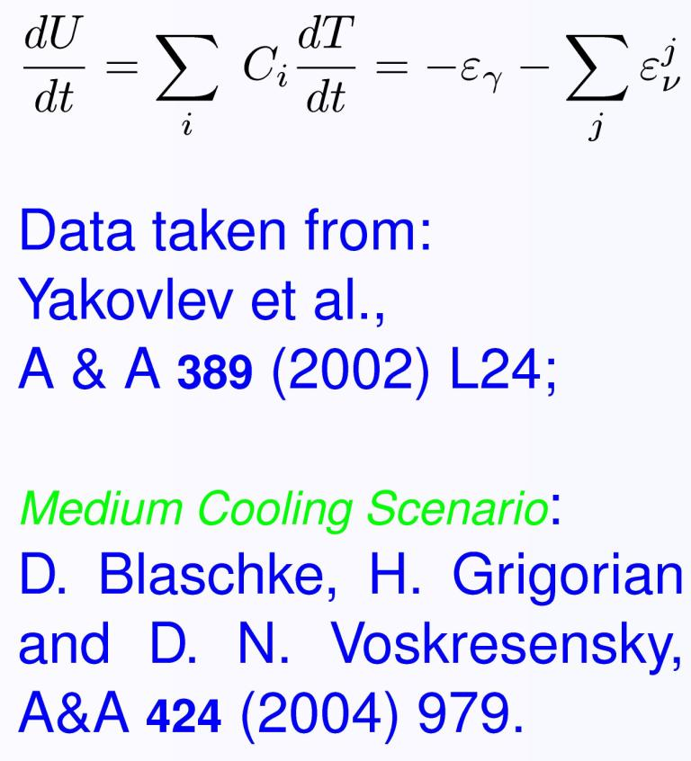
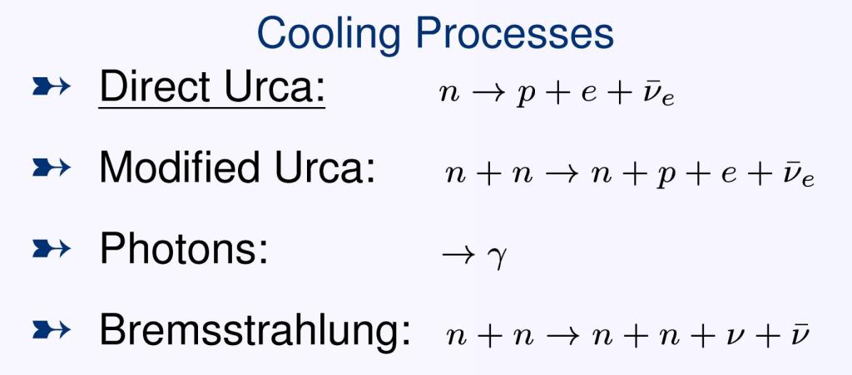
Cooling Mechanism
Notes:
12

Slide 13

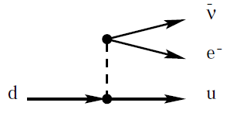

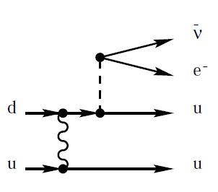

Neutrino emissivities in quark matter:
Quark direct Urca (QDU) the most efficient processes
Compression n/n0 ≃ 2 , strong coupling αs ≈ 1
Quark Modified Urca (QMU) and Quark Bremsstrahlung
Suppression due to the pairing
Enhanced cooling due to the pairing

Slide 14
SC Pairing Gaps
Notes:
14

Slide 15

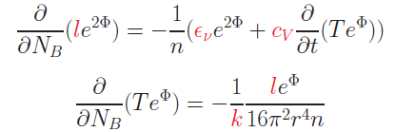

Cooling Evolution
The energy flux per unit time l(r) through a spherical slice at distance r from the center is:
The equations for energy balance and thermal energy transport are:
where n = n(r) is the baryon number density, NB = NB(r) is the total baryon number in the sphere with radius r
F.Weber: Pulsars as Astro. Labs ... (1999);
D. Blaschke Grigorian, Voskresensky, A& A 368 (2001)561.
Notes:
15

Slide 16
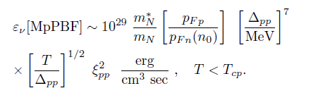
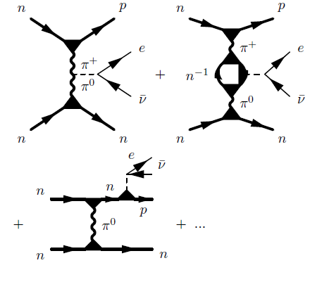
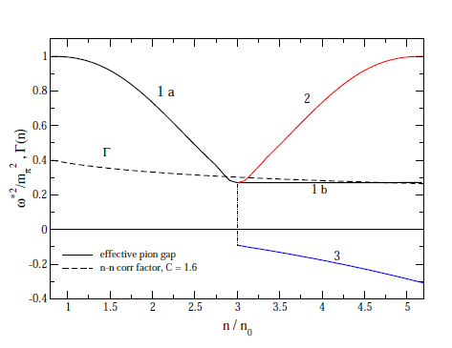

Medium Effects In Cooling Of Neutron Stars
Based on Fermi liquid theory ( Landau (1956), Migdal (1967), Migdal et al. (1990))
MMU – insted of MU
Main regulator in Minimal Cooling

Slide 17
Medium Effects In Cooling Of Neutron Stars

Slide 18
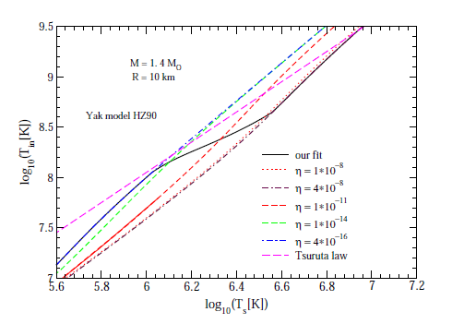

Crust Model
Time dependence of the light element contents in the crust
Blaschke, Grigorian, Voskresensky, A& A 368 (2001)561.
Page,Lattimer,Prakash & Steiner, Astrophys.J. 155,623 (2004)
Yakovlev, Levenfish, Potekhin, Gnedin & Chabrier , Astron. Astrophys , 417, 169 (2004)
Notes:
18

Slide 19
Contributions To Luminosities

Slide 20
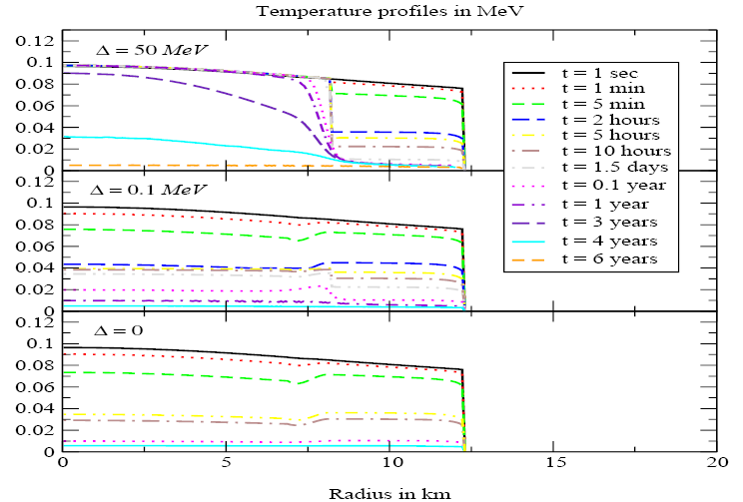
Temperature In The Hybrid Star Interior
Blaschke, Grigorian, Voskresensky, A& A 368 (2001) 561
Notes:
20

Slide 21
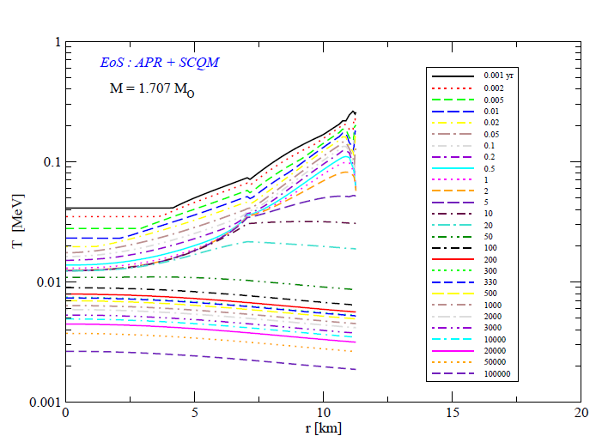
Temperature In The Hybrid Star Interior
Blaschke, Grigorian, Voskresensky, A& A 368 (2001) 561
Notes:
21

Slide 22
Cas A as an Hadronic Star

Slide 23
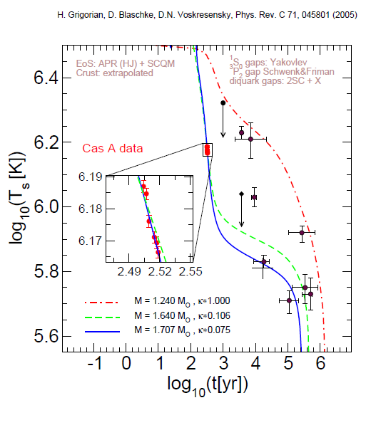
Cas A As An Hybrid Star

Slide 24
Possible internal structure of CasA

Slide 25
HDD – AV18 , Yak.
ME nc = 3 n0

Slide 26
DD2 – BCLL
ME-nc =1.5,2.0,2.5n0

Slide 27
DD2 – EEHOr
ME-nc=1.5,2.0,2.5n0

Slide 28
DD2- ME-nc = 3 n0
BCLL, EEHOr

Slide 29
DD2 vex-p40, AO
ME-nc = 2.0,2.5 n0

Slide 30
DD2 vex p40, BCLL
ME-nc = 1.5,2.0 n0

Slide 31
Conclusions for NS cooling
All known cooling data including the Cas A rapid cooling consistently described by the medium-modified superfluid cooling model
Both alternatives for the inner structure, hadronic and hybrid star, are viable (as well for Cas A; a higher star mass favors the hybrid model)
Influence of stiffness on EoS and cooling can be balanced by the choice of corresponding gap model.

Slide 32
Bayesian analysis for new class of hybrid star
EoS with M-R observations for neutron stars
Observational constraints
Bayesian Analysis
Idea of fictitious measuremets
Results
D. E. Alvarez-Castillo et al. Eur. Phys. J. A (2016) 52:69
A. Ayriyan et al. J. Phys. CS 668 (2016), 012038
A. Ayriyan et al. Phys. Part. Nucl. 46(5), 2015, 854-857
D. Blaschke et al. J. Phys. CS 496 (2014), 012002
Notes:
32

Slide 33
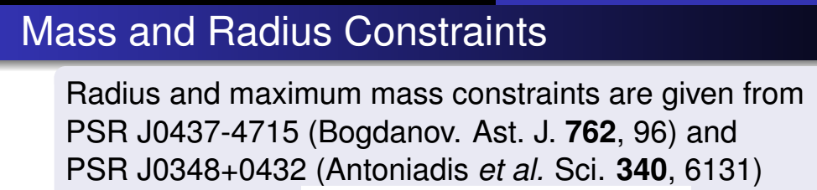
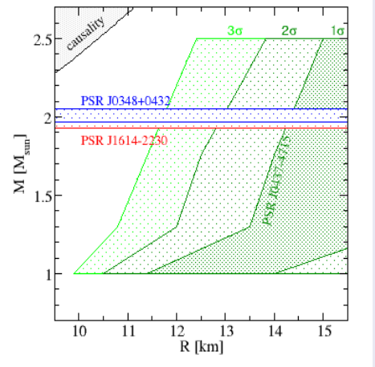

Slide 34
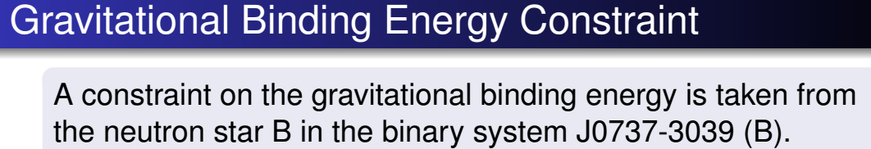
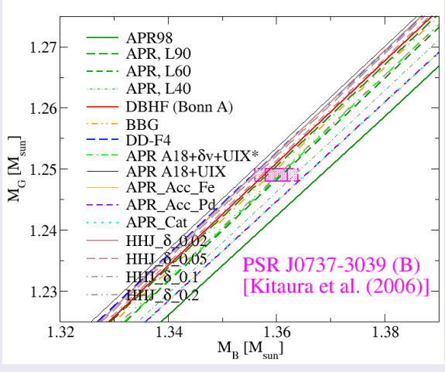

Slide 35
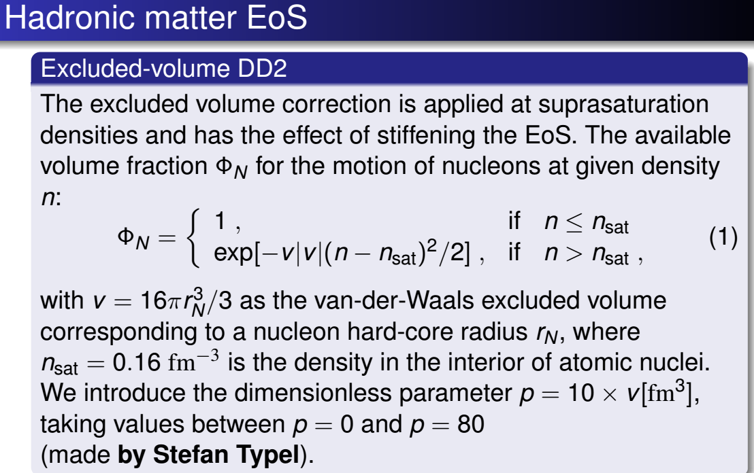
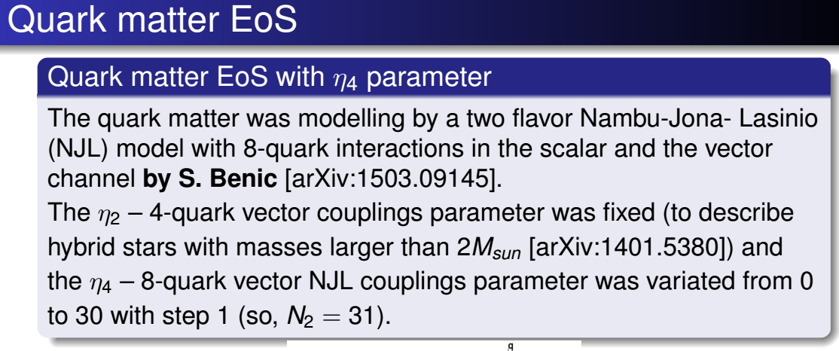

Slide 36
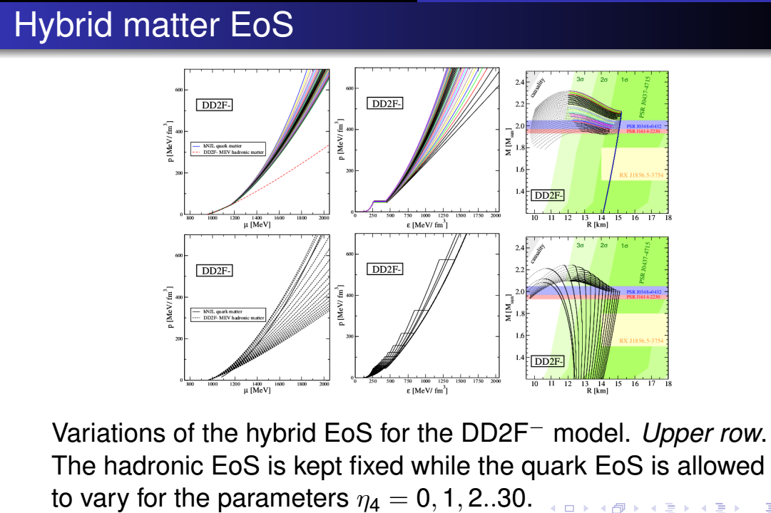

Slide 37
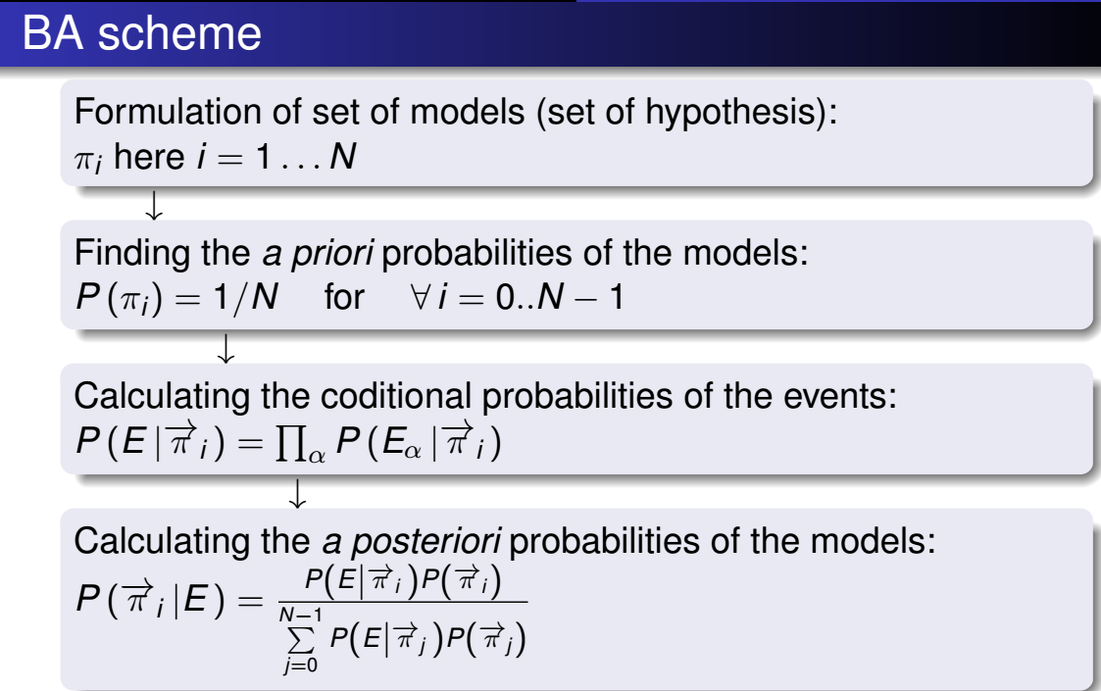
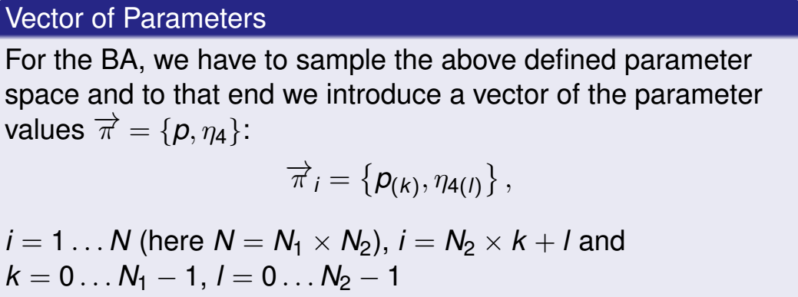

Slide 38
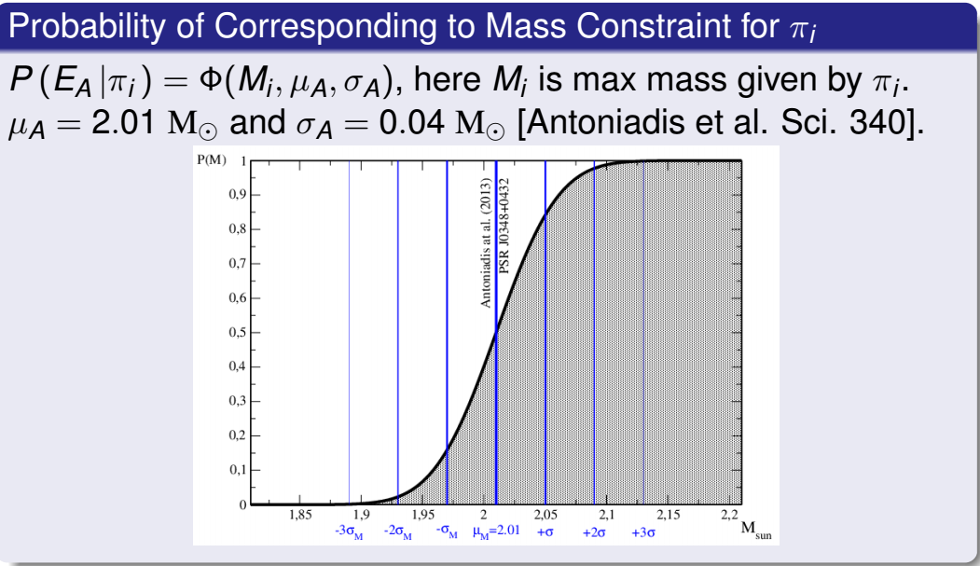
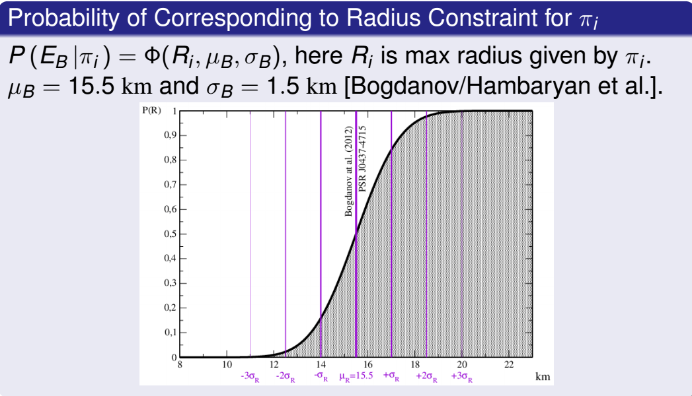
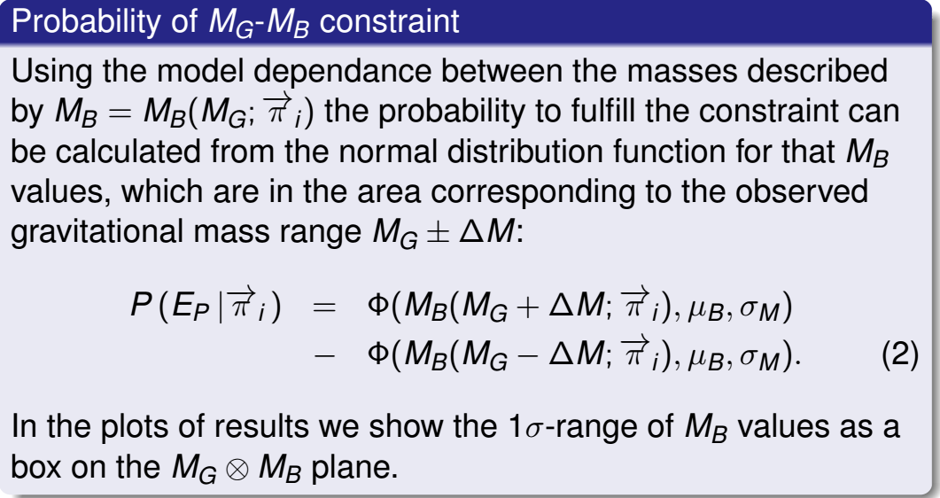

Slide 39
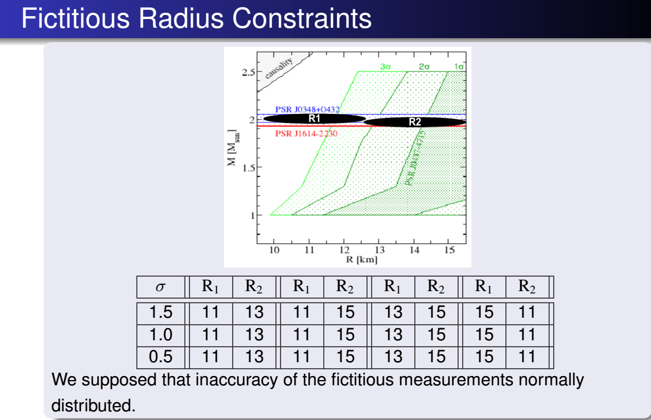

Slide 40
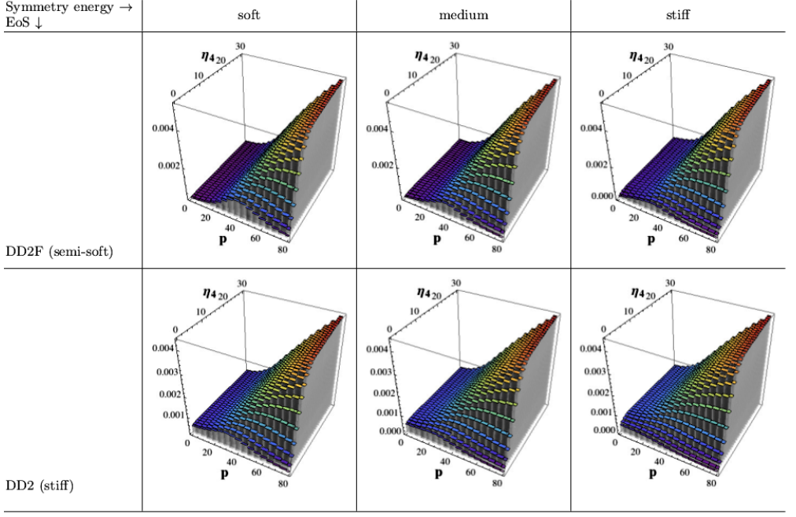

Slide 41
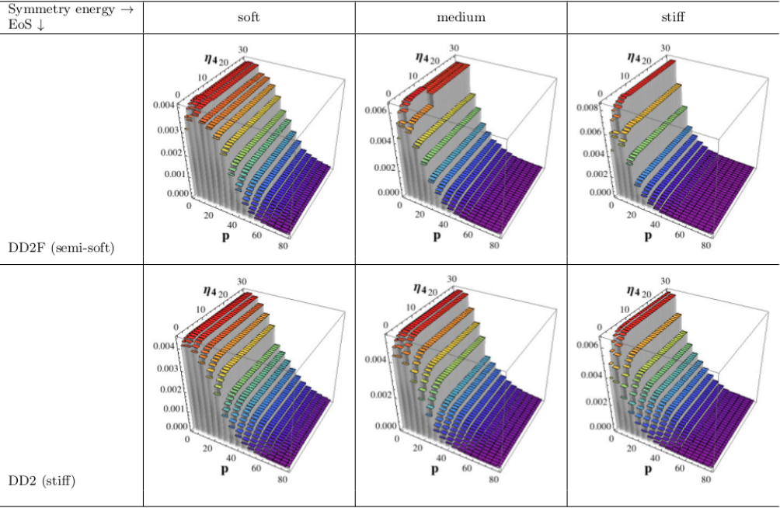

Slide 42
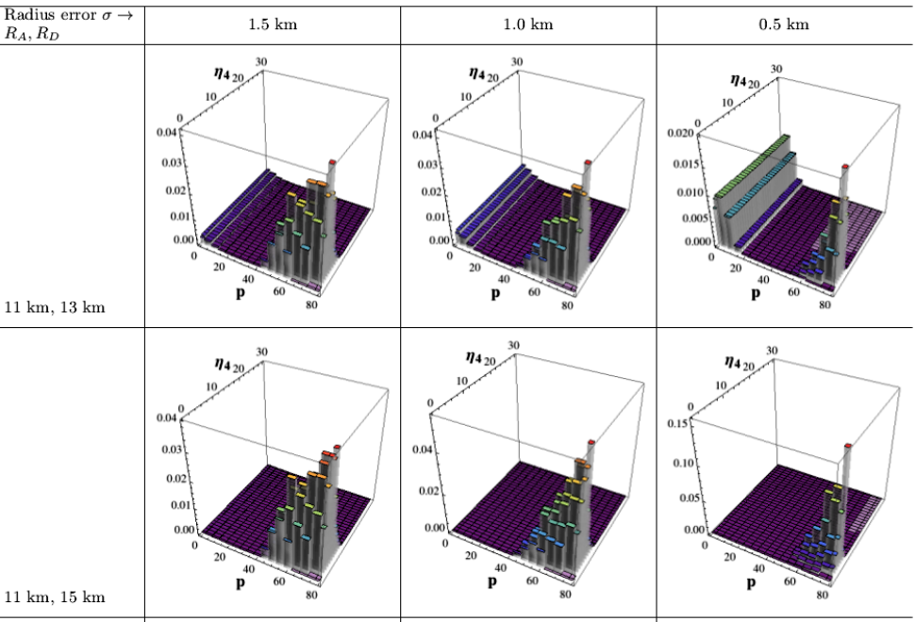

Slide 43
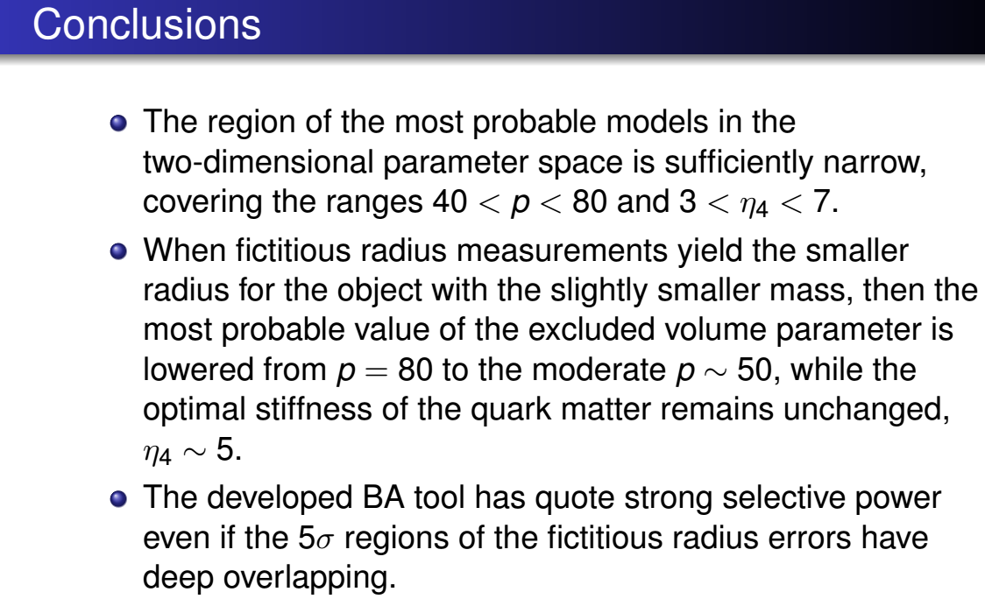

Slide 44
Thank YOU!!!!!

Slide 45
Equations for Cooling Evolution
Notes:
45

Slide 46
Boundary conditions
L_conductivity
Outer Crust of NS
r = R
L_photons
L = 0
Center of NS
r = 0
L

